Slide 1
Use of Immersive Virtual Reality in the Assessment and Treatment of Alzheimer’s Disease: A Systematic Review
Journal of Alzheimer’s Disease 2020
中科院SCI医学2区

Slide 2
Introduction
1. We define ‘immersive’ virtual reality as systems that encompass the user’s visual field and where virtual movement replicates actual head or bodily movement.
2. Modern iVR technology overcomes these issues: lag in visual updating and mismatch between visual perception and vestibular feedback (前庭神经反馈).
3. The iVR allows for naturalistic interaction with a simulated world which could potentially offer spatial cognitive tasks to AD pathology.
4. Isolated impairments in spatial navigation are specific to early AD and otherwise hippocampal strokes (海马体卒中).

Slide 3
Introduction
5. Previous reviews have looked at the use of virtual reality in diagnostic assessment of AD using a mixture of spatial cognition.
6. The validity, tolerability, and possible diagnostic utility of immersive tasks for AD remains unclear.

Slide 4
Method
1. Database: PubMed, Embase, Cinahl, PsycINFO, the Cochrane Library, the Web of Science Core Collection.
2. Date: <= July 26, 2019.
3. Key terms: “Virtual Realit*” and “VR” and “computer (simulation* OR generat* OR therap* OR treatment*)” and “Alzeimer*”.
4. Inclusion:
(1) participants with AD or MCI at high risk of developing into AD.
(2) iVR
(3) Quantitative or qualitative outcomes.

Slide 5
Method
5. Exclusion:
(1) Only includes healthy people.
(2) No iVR.
(3) Reviews/technology appraisals.
6. Selection process: Search -> Title/abstract screening -> Manual screening of review -> Full text eligibility review -> Final screening during data extraction.

Slide 6
Method
7. Data extraction:
(1) Data of publication, authors, title, year.
(2) Method.
(3) Study design, setting.
(4) Outcome measures, type of analysis.
(5) Results.
(6) Summary.

Slide 7
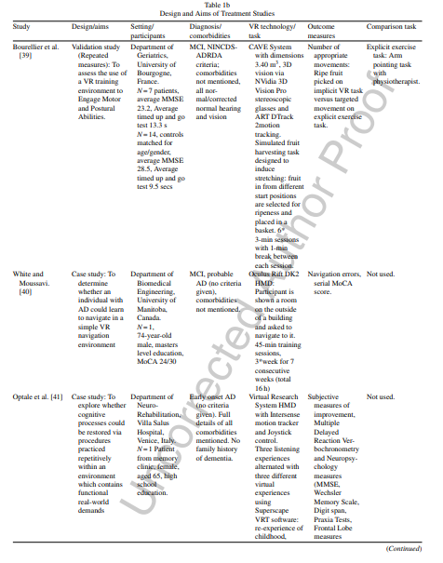
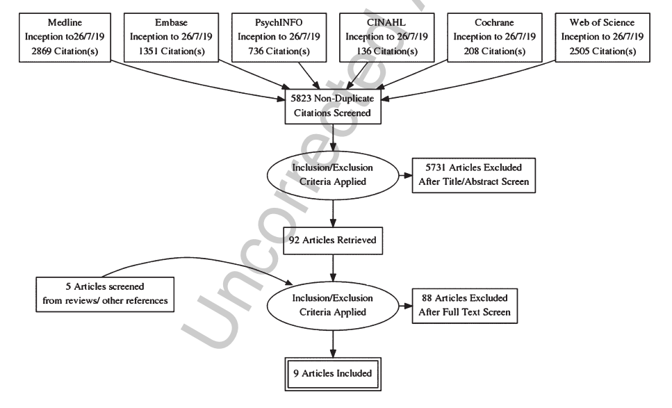
Results

Slide 8
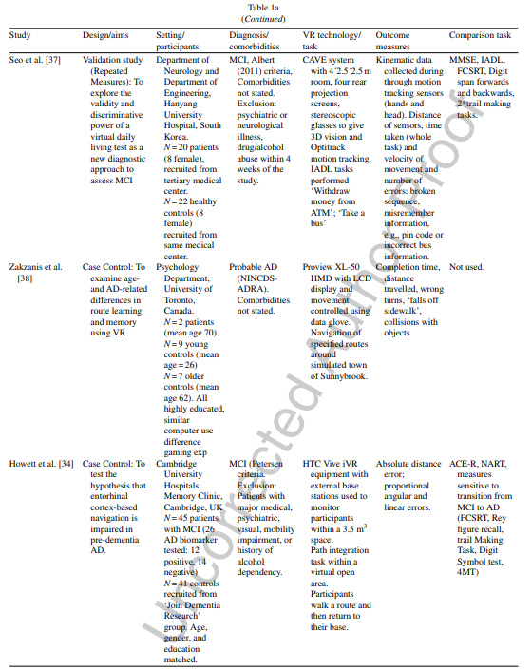
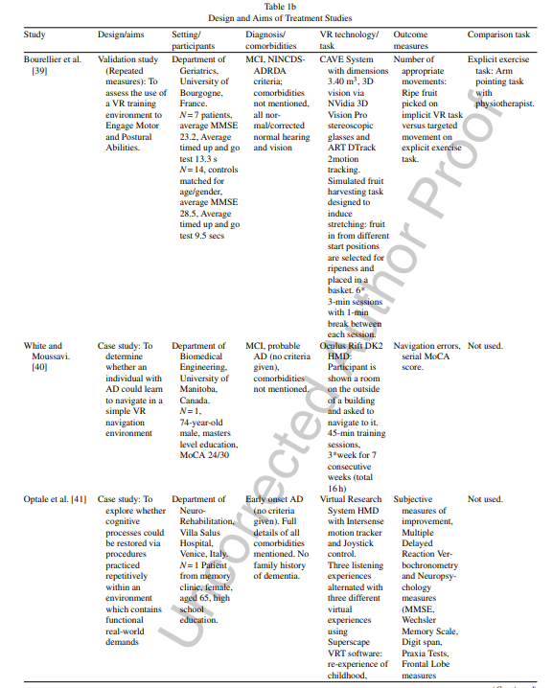

Slide 9
Discussion
1. The iVR offers distinct advantages for research and therapy reliant on movement and engagement in physical space.
2. The iVR equipment continues to improve and become more affordable. Several of the studies included use off the shelf commercial iVR equipment.
3. The iVR can be used to discriminate people with AD from controls/other dementia processes.
4. There is limited evidence that iVR can contribute to improvements in real-world function.
5. There was a lack of longitudinal studies.

Slide 10
Conclusions
1. This systematic review shows the field of iVR for the assessment and treatment of AD is starting to step out its infancy.
2. It is still less clear whether iVR can offer any specific cognitive benefits.
3. The iVR has already demonstrated remark able discriminative potential for detecting preclinical.

Slide 11
下周计划
写毕业论文。
阅读一篇论文。

